Slide 1
Introduction to Pen Testing and OSINT
Cybersecurity
Lesson 15.1

Slide 2

Learning Objectives
By the end of today’s class, you will be able to:
1
Understand the role of a pen tester in assessing a business's security.
2
Collect domain information by using OSINT techniques and tools like Google hacking, Shodan, and certificate transparency.
3
Use Shodan and Recon-ng to discover domain server information.

Slide 4
Introduction to Penetration Testing

Slide 5

Introduction to Penetration Testing
Today, we will cover the following:
An introduction to penetration testing and its business goals
A high-level overview of the various stages of a pen test engagement
A deep dive into
the first step of
a penetration test: planning and reconnaissance

Slide 6

Important!
The techniques that we’ll learn in this unit can be used to break into networks and do serious damage to an organization's infrastructure.
This is illegal when done without permission.
The tools and techniques we’ll discuss are serious, and misusing them has serious consequences.
Do not practice these techniques against computers that you do not own or have clear written permission to interact with.

Slide 7
Penetration testing, often referred to as pen testing or ethical hacking, is the offensive security practice of attacking a network using the same techniques that a malicious hacker would use, in an effort to identify security holes and raise awareness within an organization.

Slide 8

Penetration Testing
Organizations hire pen testers to assess their security controls. Pen testers find flaws in those controls, help the organization understand these flaws, and provide recommendations about which vulnerabilities to prioritize and how to fix them.
Pen tests are often administered by consultancies, which can take an “outside” view of a client’s networks.
In the simplest terms, pen testers aim to break into a client's machine, infrastructure, or even physical premises to help the client improve their security.

Slide 9

Penetration Testing
Penetration testing is often referred to as an engagement.
Pen testers, unlike malicious hackers, begin engagement only after receiving permission.
Pen testers use a combination of automated and manual tools to:
Research vulnerabilities
Craft phishing emails
Manually exploit hosts
Write shell code

Slide 10

Module Overview and Penetration Testing Phases

Slide 11


This Week’s Scenario
This week, you will play the role of consultants at GoodCorp who have been hired to conduct a penetration test against MegaCorpOne.
MegaCorpOne is an organization that specializes in disruptive innovation in the nanotechnology industry and has hired GoodCorp to run a penetration test.
You will be tasked with going through the penetration testing engagement to assess MegaCorpOne's security.
You will conclude the test with a report of your findings, so be sure to keep all of your findings as you proceed through the penetration testing activities.
Notes:
shutterstock_1888488028

Slide 12

Penetration testers follow a methodology during an engagement that is designed to mimic that
of an actual attack.
Reporting
Reporting
Post exploitation
Post exploitation
Exploitation
This helps network defenders understand how effective their organization’s defenses are.
Exploitation
Scanning
Scanning
Planning and reconnaissance
Planning and reconnaissance

Slide 13
Pen Testing Phases
An engagement consists of five phases:
01A
Planning
Define the purpose and scope of the test, and sign all legal contracts.
01B
Reconnaissance
Obtain publicly available information about your target.
02
Scanning
Use tools to run a scan against your target to gather information, such as open ports, and run services to determine potential vulnerabilities.
03
Exploitation
Attack the vulnerabilities discovered in the previous steps to gain access to the target.
04
Post exploitation
Gather valuable information from the compromised systems.
05
Reporting
Report on the previous five steps to provide a summary of actions taken, findings, and recommended mitigations.

Slide 14

Module Progression
Over the four classes in this unit, we will proceed through these five phases as we conduct a penetration test against MegaCorpOne.
Day 1
Day 2
Day 3
Day 3-4
Day 4
Today
Planning
Scanning
Exploitation
Post
exploitation
Reporting
Reconnaissance
Keep your findings from each activity. You will use them on the fourth day when you create your penetration test report.

Slide 15


While we’ve shown these phases sequentially, there are times when steps are skipped, repeated, or when their order is switched – just like in a real attack.

Slide 16
Planning the Penetration Test

Slide 17

Phase 1: Planning
The planning step is an interaction between the organization and the pen testing team. It helps pen testers thoroughly understand the client’s needs before beginning the test.
Most businesses’ primary interest is not how attackers might gain access to their networks.
Instead, their main concern is the major consequences that an exploited vulnerability may have for their reputation, operations, or bottom line.

Slide 18

Purpose and Scope
Planning usually begins with a kick-off meeting, during which clients work with pen testers to determine the purpose and scope of the project.
Purpose
is defined by the business’s needs and the assets the business is most interested in
protecting.
Scope
is defined by which machines and networks are off limits to pen testers.

Slide 19
Phase 1: Planning
The primary deliverable from this stage is a document summarizing the:
Engagement’s purpose
Scope
Associated details such as timeframe and emergency contacts

Slide 20
Types of Penetration Testing

Slide 21


Types of Penetration Testing
There are three types of penetration tests:
No view
Full view
Partial view
Also known as
black box
Also known as
white box
Also known as
gray box

Slide 22

No-View Pen Testing
In no-view testing, the pen tester simulates a malicious hacker who has no prior knowledge of the target system and network:
The pen tester is paid to learn and exploit as much as they can about the network using only the tools publicly available to an attacker on the internet.
For example, they may know only the company name and have to find various key resources, like IP ranges and access credentials.
No
Knowledge

Slide 23

Full-View Pen Testing
In full-view testing, the pen tester is given full knowledge of the system or network:
This knowledge allows them to tear apart subtle security issues on behalf of their clients.
Full-view pen testing is most appropriate when the client wants a detailed analysis of all potential security flaws, rather than exposed and visible vulnerabilities.
Full-view testers are given: network diagrams, access credentials to the networks, system names, usernames, emails, and phone numbers.
Full
Knowledge

Slide 24

Partial-View Pen Testing
Partial-view pen testing is performed by the in-house system or network admin.
Regardless of the scenario, the main deliverable for any pen tester is a report that summarizes their findings and recommendations for improvements.
Some
Knowledge

Slide 25
The main deliverable for any pen tester is a report that summarizes their findings and recommendations for improvements.

Slide 26

Statements of Work and
Legal Indemnification

Slide 27

Statements of Work & Legal Indemnification
Before beginning a security assessment, several legal steps must be completed.
Since penetration testing is hacking,
the entity being hacked must consent to the test.
To protect the assessors from legal ramifications, a statement of work (SoW) must be agreed upon and signed by both parties.

Slide 28
A SoW outlines the scope of the test, the timeline, the points of contact, and how the test will be conducted.

Slide 29

Penetration testing without a contractual agreement is illegal, unless it is conducted on your own network or devices.

Slide 30

Scenario 1:
A financial institution asks you to perform a penetration test on their private network.
They will give you access to all the credentials and architecture diagrams that you may need.
You will also meet with them beforehand to sign a contract clearly illustrating the scope and purpose of the test.
Notes:
shutterstock_1036284196

Slide 31
Scenario 1:
A financial institution asks you to perform a penetration test on their private network.
They will give you access to all the credentials and architecture diagrams you may need.
You will also meet with them beforehand to sign a contract clearly illustrating the scope and purpose of the test.
This is a legal full-view penetration test, because you have signed a contract before you begin your assessment.
Notes:
shutterstock_1036284196

Slide 32
Scenario 2:
A friend has verbally asked you to perform a penetration test on a social media website they just joined as they want to make sure their information is safe.
Notes:
shutterstock_1036284196

Slide 33
Scenario 2:
A friend has verbally asked you to perform a penetration test on a social media website they just joined as they want to make sure their information is safe.
This is an illegal no-view test, because neither the friend nor you own the social media website network or devices, and the social media website has not granted permission or signed a contract authorizing this test.
Notes:
shutterstock_1036284196

Slide 35
Summary
Penetration testing, often referred to as pen testing or ethical hacking, is the offensive security practice of attacking a network using the same techniques that a malicious hacker uses.
The five phases of a pen testing engagement are: Planning and Reconnaissance, Scanning, Exploitation, Post-Exploitation, and Reporting.
During the planning phase, the engagement’s scope and purpose are defined.
The scope includes the type of penetration test that will be run. Types include no view,
full view, and partial view.
A SoW is also completed during the planning phase. It outlines the scope of the test, the timeline, the points of contact, and how the test will be conducted.

Slide 36
Types of Penetration Testing
In this activity, you will work as a security consultant at GoodCorp, who's been hired to perform penetration tests.
You have just been given a list of potential contract opportunities.
Your first task it to evaluate the list and determine:
  Whether the assessment is legal or illegal
  The type of penetration test being requested
15 Minutes

Slide 39

Intro to MITRE ATT&CK®

Slide 40
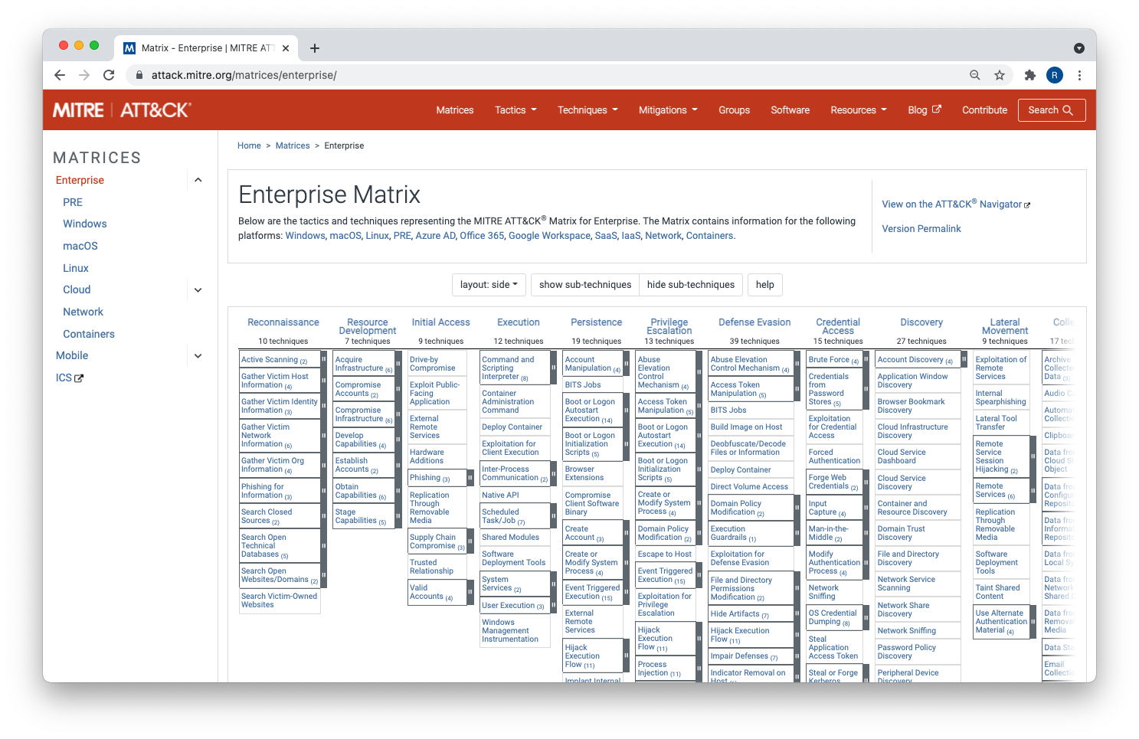
MITRE ATT&CK®
The MITRE ATT&CK® Matrix provides a visual representation of all the techniques, tactics, and procedures (TTPs) that may be performed throughout an assessment.
We will use this matrix as a reference for the TTPs that we will conduct throughout the next two weeks.

Slide 41
MITRE ATT&CK®
The matrix consists of the following:
Tactics/Headers
Each header represents a tactic.
For example, the first tactic listed is reconnaissance.
It’s listed first because attackers conduct reconnaissance on a target before actually performing any exploitation.

Slide 42
MITRE ATT&CK®
The matrix consists of the following:
Techniques/Rows
Each row under the header is a technique.
For each tactic, there are multiple techniques.
For example, during reconnaissance, an attacker may use active scanning to gather information about a target, or they may search open technical databases to gather similar information.

Slide 43

MITRE ATT&CK®
It is a “hacker’s playbook.”
The matrix is comprehensive, meaning that virtually every potential attack falls under a tactic and maps to a specific technique.
As a penetration tester, it’s beneficial to map out the techniques that you performed in an assessment so that the customer can learn which TTPs were successful and what needs to be addressed.

Slide 44
MITRE ATT&CK®
This is a powerful matrix to follow and reference
Comprehensive
Reporting
Categorizing
It is comprehensive and includes almost every possible tactic or technique that an attacker could employ during a hack.
In your final report, it provides a way to refer to tactics and techniques that an attacker would use in a manner that less-technical staff can understand.
It helps create a more comprehensive report by categorizing specific security deficiencies.

Slide 45
MITRE ATT&CK®
This week’s unit will follow the MITRE ATT&CK® Matrix tactics from left to right.
We won’t cover every tactic due to time constraints, but we’ll begin by learning about reconnaissance today.
Reconnaissance
Resource development
Initial
access
Execution
Persistence
Privilege escalation
Defense
evasion
Credential access
Discovery
Lateral movement
10 techniques
7 techniques
9 techniques
12 techniques
19 techniques
13 techniques
39 techniques
15 techniques
27 techniques
9 techniques

Slide 46

Reconnaissance with OSINT
and Google Hacking

Slide 47
Reconnaissance is the first MITRE ATT&CK tactic.

Slide 48
Reconnaissance, or recon, means gathering information about your target.

Slide 49
Reconnaissance
Reconnaissance is divided into two types:
01
Passive Recon
02
Active Recon
Often refers to open source intelligence (OSINT), which leverages information about the target that is publicly available on the internet.
This includes all domains and
hosts belonging to a target that are publicly viewable.
Also refers to gathering information about the target, but it involves directly interacting with the target.

Slide 50

Reconnaissance
Reconnaissance can be conducted:
Externally
from the target
(external reconnaissance)
Internally
after accessing
the target
(internal reconnaissance)

Slide 51

Enables us to manipulate Google searches to narrow down our queries in order to acquire actionable intel.

Slide 52
Falls under the technique:
Search Open Websites/Domains: Search Engines, ID T1593-002.

Slide 53

Demonstration Scenario
In this demonstration, we’ll use Google hacking basic functionality to target sans.org.
Then you will apply this tool to gather OSINT in the next activity.
Notes:
shutterstock_1888488028

Slide 54
Google Hacking

Slide 55

Summary
We’ve covered the following concepts:
Reconnaissance | Gathering information about your target. It’s part of the Planning and Reconnaissance phase.
Passive Recon | Leveraging information about the target that is publicly available on the internet. Often refers to open source intelligence (OSINT).
Active Recon | Directly interacting with the target to obtain information.
External Reconnaissance | Reconnaissance that is conducted externally from the target.
Internal Reconnaissance | Reconnaissance that is conducted internally after accessing the target.
Google Hacking | A reconnaissance tactic that enables us to manipulate Google searches to narrow down our queries to acquire actionable intel.

Slide 56
Google Hacking
As a penetration tester for GoodCorp, you have been tasked with conducting an engagement against the fictional company MegaCorpOne.
You will start by using Google hacking to find information pertaining to MegaCorpOne.
15 Minutes

Slide 60

Certificate Transparency

Slide 61
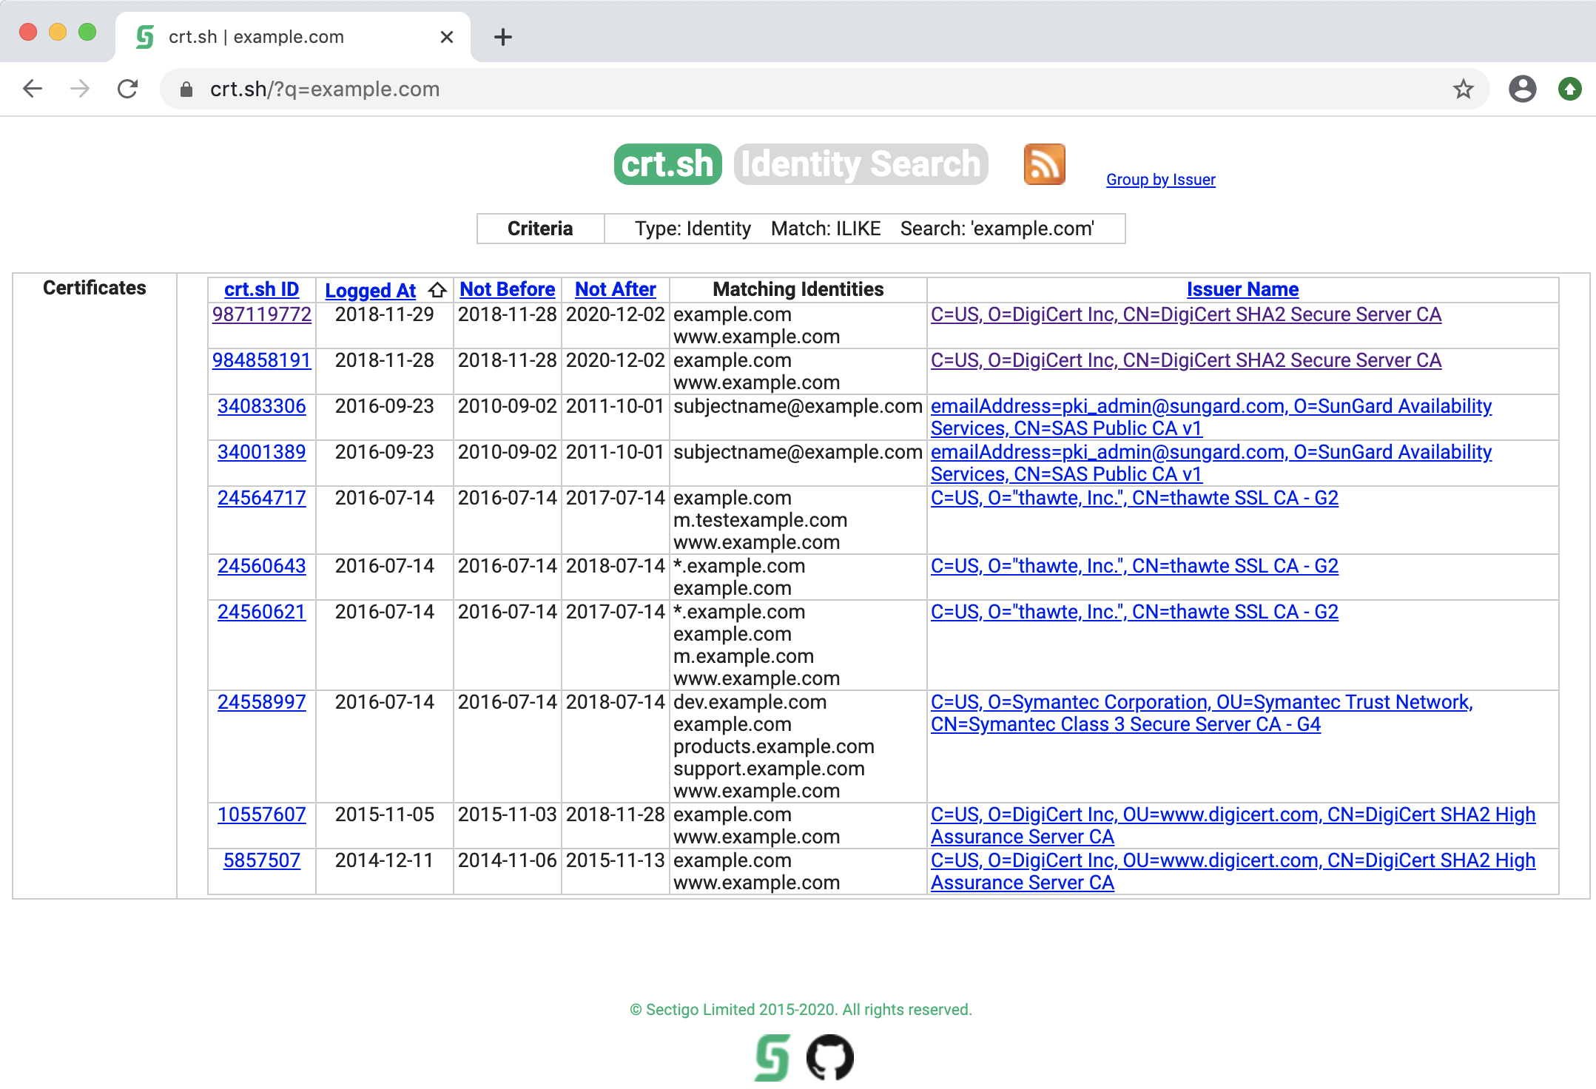
Certificate Transparency
Certificate issuers publish logs of SSL/TLS certificates that they issue to organizations.
This is known as certificate transparency. Attackers can exploit it to search for subdomains.
This falls under the Search Open Technical Databases:
Digital Certificates MITRE technique, ID T1596.003.

Slide 62
Certificate Transparency

Slide 63

Shodan.io

Slide 64
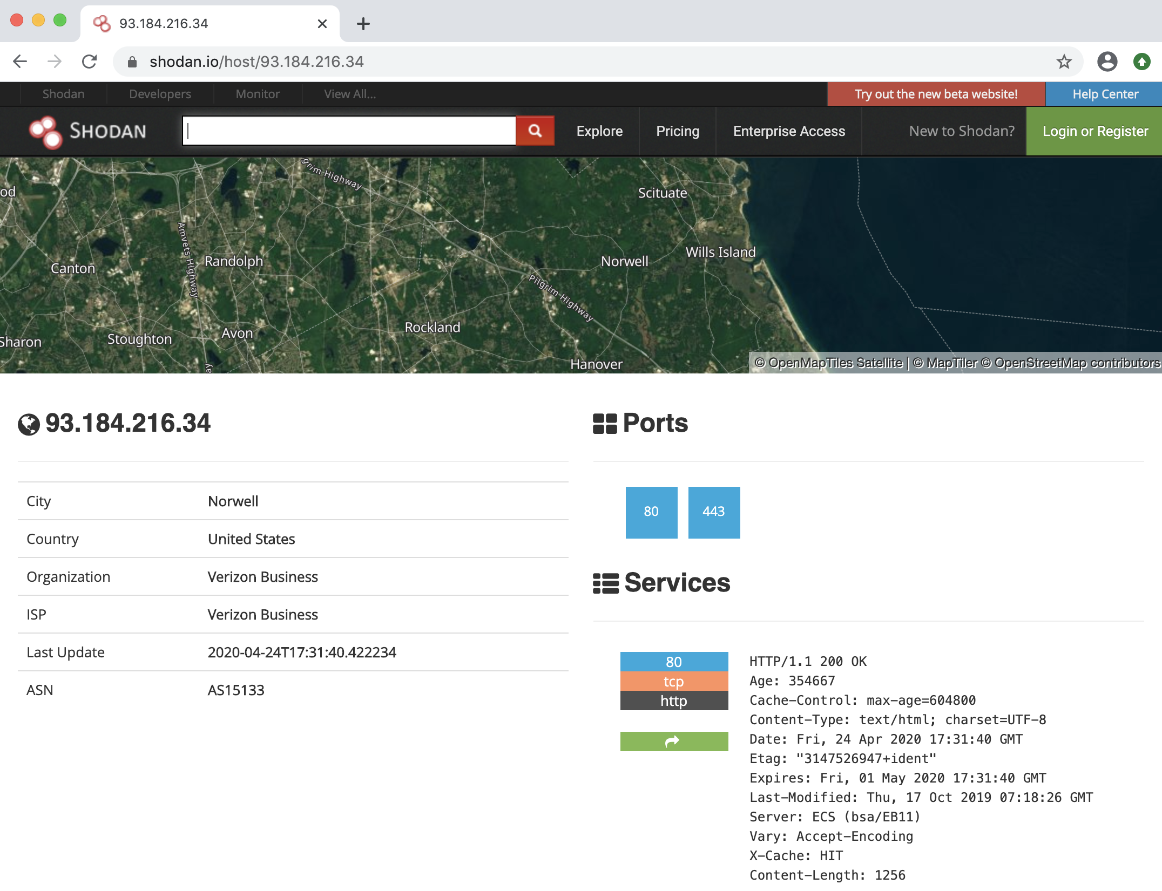
Shodan.io
Shodan.io conducts port scanning across the entire internet and catalogs the results for quick searching.
This saves us the time we would spend conducting a port scan. Not conducting the scan also allows us to keep our originating IP address hidden.
This falls under the MITRE technique Search Open Technical Databases: Scan Databases, ID T1596.005.

Slide 65
Shodan.io

Slide 66
MITRE ATT&CK®
We’ve covered the following concepts:
Certificate Transparency
A reconnaissance tactic whereby a penetration tester can gather information from certificate issuers, who publish logs of the SSL/TLS certificates that they issue to organizations.
Shodan.io
A reconnaissance website that conducts port scanning across the entire internet and catalogs the results for quick searching.

Slide 67
Shodan.io
In this activity, you will continue to play the role of a pen tester conducting an engagement on MegaCorpOne.
You are now tasked with performing OSINT by using Shodan.io.
15 Minutes

Slide 70

recon-ng

Slide 72
Recap
Steps we have taken so far:
01
We undertook the planning part of the planning and reconnaissance phase.
02
We began passive reconnaissance by using Google hacking.
03
We used Shodan.io to view previously completed port scans on several targets.

Slide 73
Now we'll continue our reconnaissance efforts with another tool called recon-ng.

Slide 74


recon-ng
recon-ng is a web reconnaissance framework written in Python
Recon-ng provides a powerful, open-source, web-based framework for conducting reconnaissance quickly and thoroughly. It includes the following features:
Independent modules
Database interaction
Built-in convenience functions
Interactive help
Command completion

Slide 75
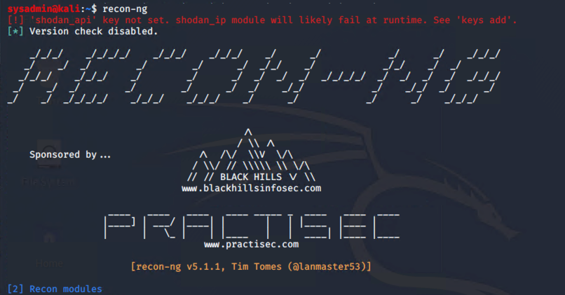
recon-ng
There are many scripts that can assist with integrating OSINT tools into recon-ng
recon-ng is a framework that ingests a lot of popular OSINT modules, allowing the results of multiple tools to be combined into a single report.

Slide 76
recon-ng

Slide 77
recon-ng
In this activity, you will continue to play the role of a pen tester conducting an engagement on MegaCorpOne.
You are tasked with determining whether MegaCorpOne's domain server info is accessible using OSINT tools.
You will use the Shodan API and recon-ng to perform your tests, and then you'll place all of your findings in a report.
15 Minutes

Slide 80
Initial Access and Internal Recon

